Slide 1
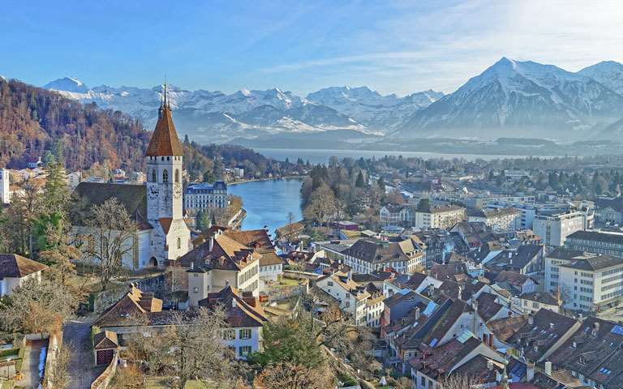
Rhineland
Pim Huisman – Concept / Environment Art
Scott Vetketel – Environment Art
Jens Walgien – Character Art
Jorrit Kornelis – Producer
Daniël Stremmelaar – Programmer / Game Design

Slide 2
Inhoud
Changes
Reflection
Art Progression
Plans
Prototype

Slide 3
Changes
Resources
Upgrade system
Supply chain

Slide 4
Art Progression

Slide 5
Plans
Happiness
Starvation
Random map
Spawn selection

Slide 6
Prototype

